Slide 1


DataSpark: Illuminating Insights for Global Electronics
This presentation explores the power of data analysis in the global electronics industry. We'll delve into how Python and MySQL can be used to extract valuable insights from customer, sales, product, and store data.
by Bharath Roshan

Slide 2

Data Cleaning and Preparation in Python
1
Initial Steps
2
Structured Analysis
The initial data preparation steps involve importing necessary libraries, loading data using pd.read_csv(), and handling missing values, data type conversions, and date formatting.
Preparing data for structured analysis ensures that the data is clean and usable for analysis. This involves transforming raw data into a format that can be easily interpreted and analyzed.

Slide 3




Importing Data into MySQL Database
Connection Setup
The first step is to set up a connection to the MySQL database, including providing the necessary credentials.
Data Import
Use the to_sql() function to import pandas DataFrames into the database, creating tables for each DataFrame.
Error Handling
Implement error handling to ensure a smooth data transfer process and display success messages upon completion.

Slide 4
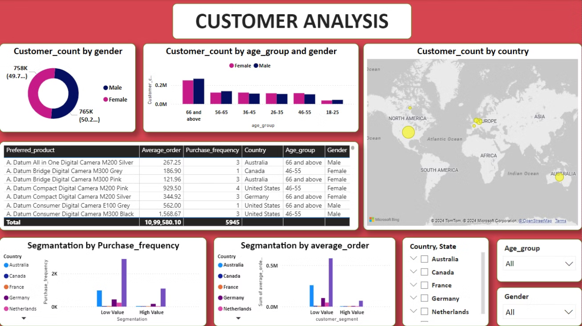
Customer Analysis: Insights from Data
Demographics
Customer analysis begins by examining demographics such as gender and age group distribution. This provides insights into the target audience and their preferences.
Purchase Behavior
Analyzing purchase frequency and average order value by demographic groups reveals spending trends and customer loyalty patterns.

Slide 5
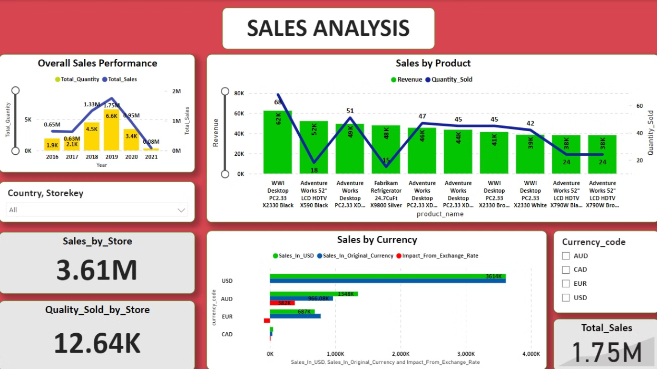
Sales Analysis: Trends and Insights
Analyzing total sales over time provides a clear picture of sales performance and growth patterns. This analysis can identify seasonal trends, growth spikes, and potential areas for improvement. By understanding these trends, businesses can make informed decisions about inventory management, marketing strategies, and resource allocation.
Identifying top products by revenue helps understand which products are driving sales and customer demand. This information is valuable for product development and marketing strategies. Understanding customer preferences and purchasing behavior can lead to targeted marketing campaigns and product enhancements that cater to the most popular items.
Examining the impact of currency fluctuations on sales amounts is crucial for understanding the financial performance of the business. When dealing with international transactions, it's important to assess the impact of currency exchange rates on revenue. By monitoring currency trends and implementing hedging strategies, businesses can mitigate the risk of currency fluctuations and maintain financial stability.

Slide 6
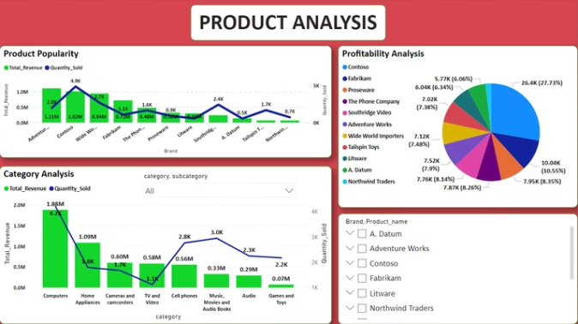
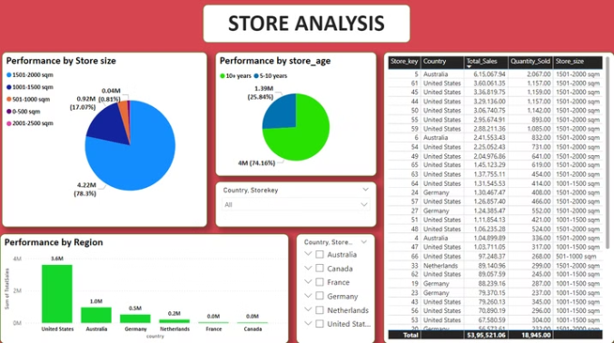
Product & Store Analysis: Profitability and Performance
Product Profitability
Revenue, Cost, Profit Margins
Store Metrics
Sales Performance by Location, Opening Date
Analyzing product and store data provides key insights into profitability and performance. Product profitability can be examined by analyzing revenue, cost, and profit margins. For example, you can identify products with high profit margins or products with low profit margins that may require optimization. Examining sales performance by location allows you to understand which stores are performing well and which stores need improvement. You can also analyze the performance of different stores based on opening date to understand the impact of store age on profitability and sales. This data is crucial for informing business decisions such as product pricing, marketing strategies, and store expansion plans.

Slide 7

Project Summary & Key Takeaways
Data Preparation
MySQL Integration
The project involved cleaning and preparing data using Python, ensuring accuracy and consistency.
Data was then integrated into a MySQL database for efficient storage and management.
Data Analysis
Customer, sales, product, and store data were analyzed to extract valuable insights.

Slide 8

Conclusion
By combining Python and MySQL, we've demonstrated how data analysis can provide valuable insights for decision-making in the global electronics industry. These insights can help businesses optimize their operations, understand customer behavior, and make informed decisions about product development and marketing strategies.

